Slide 1

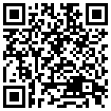
Trends in vegetation changes over wetland areas in Denmark using remote sensing data

Slide 2

Context
Time series analyses based on satellite images and spectral indices have become a new tool for accurate monitoring of the land use and cover changes over large areas. Change detection methods between two years based on bi-temporal information may lead up to the detection of pseudo-changes, which hinders the land-use and cover monitoring process at different scales.
This work aims to determine the trends of vegetation spectral response expressed as the Normalized Difference Vegetation Index (NDVI) over the period 2005 and 2020 and compare these trends with the land-use and cover changes in the same period for wetland areas across Denmark.
We studied the potentiality of including NDVI temporal curves derived from a yearly time-series Landsat TM images (30-m spatial resolution) to obtain more accurate change detection results. We computed the NDVI temporal trends using pixel-wise Theil-Sen and Man-Kendall tests, then we explored the relationship between NDVI trends and the different land-use and cover change classes.

Slide 3
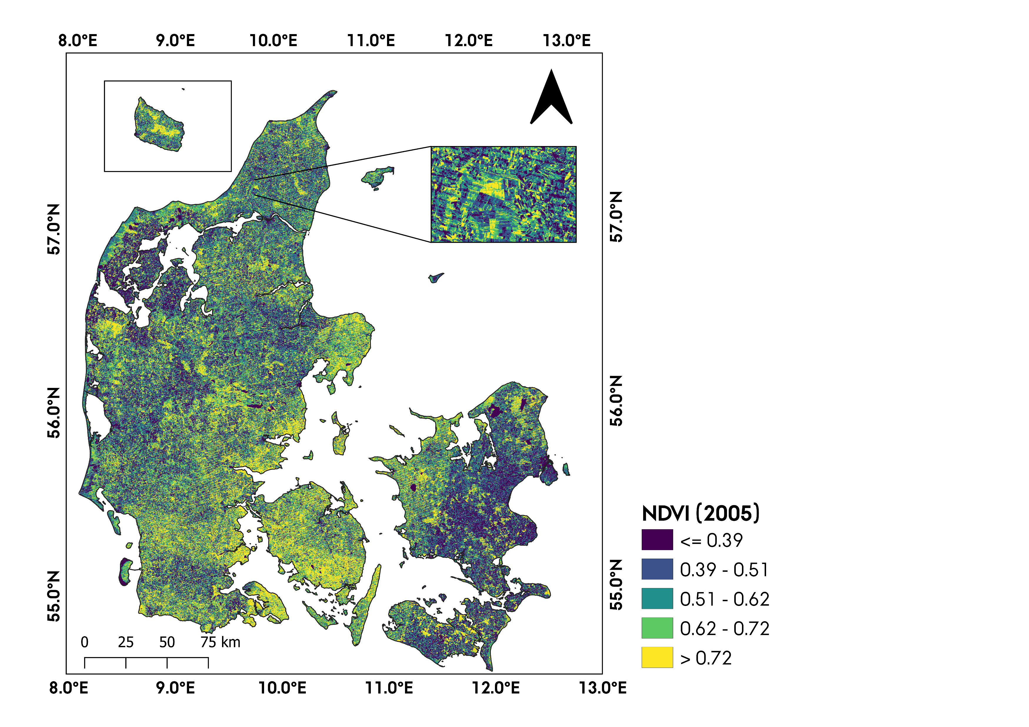

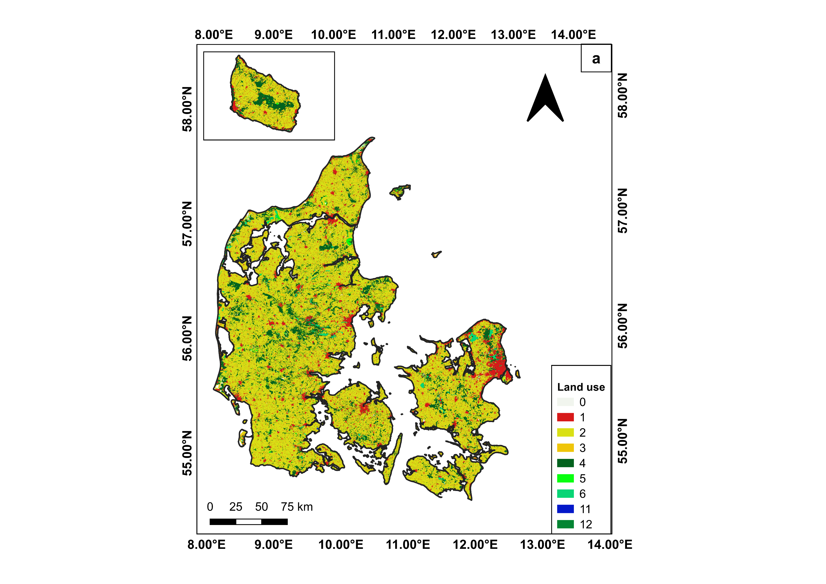
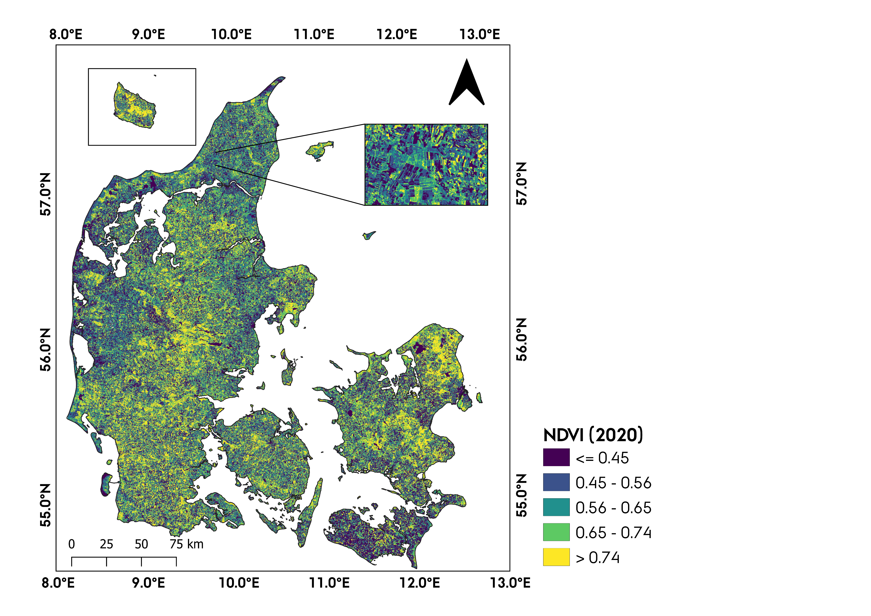

MethoDS
Landsat 7 ETM Tier 1
Landsat 8 OLI Tier 1
2005
2020
NDVI
Pixel-wise Theil-sen regression and Mann-Kendall trend test (10.645.135 pixels) – Wetland areas
Land use layer 2005
NDVI
Slope
P-value
2005
2020
Time
Land use transition matrix
NDVI slope classification
N1: Slope<0 & p-value>0.1
N2: Slope<0 & 0.05<p-value≤0.1
N3: Slope<0 & p-value ≤ 0.05
P1: Slope>0 & p-value>0.1
P2: Slope>0 & 0.05<p-value≤0.1
P3: Slope>0 & p-value>0.05
Land use layer 2020
Chi-square test – determine whether NDVI slope classes and land use transitions are likely to be related or not.
Annual NDVI time series (2005-2020)

Slide 4
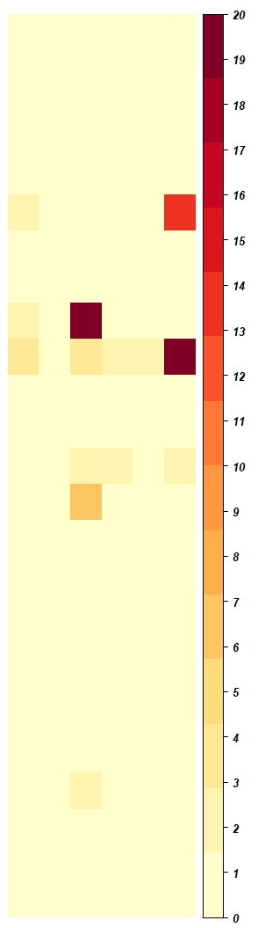
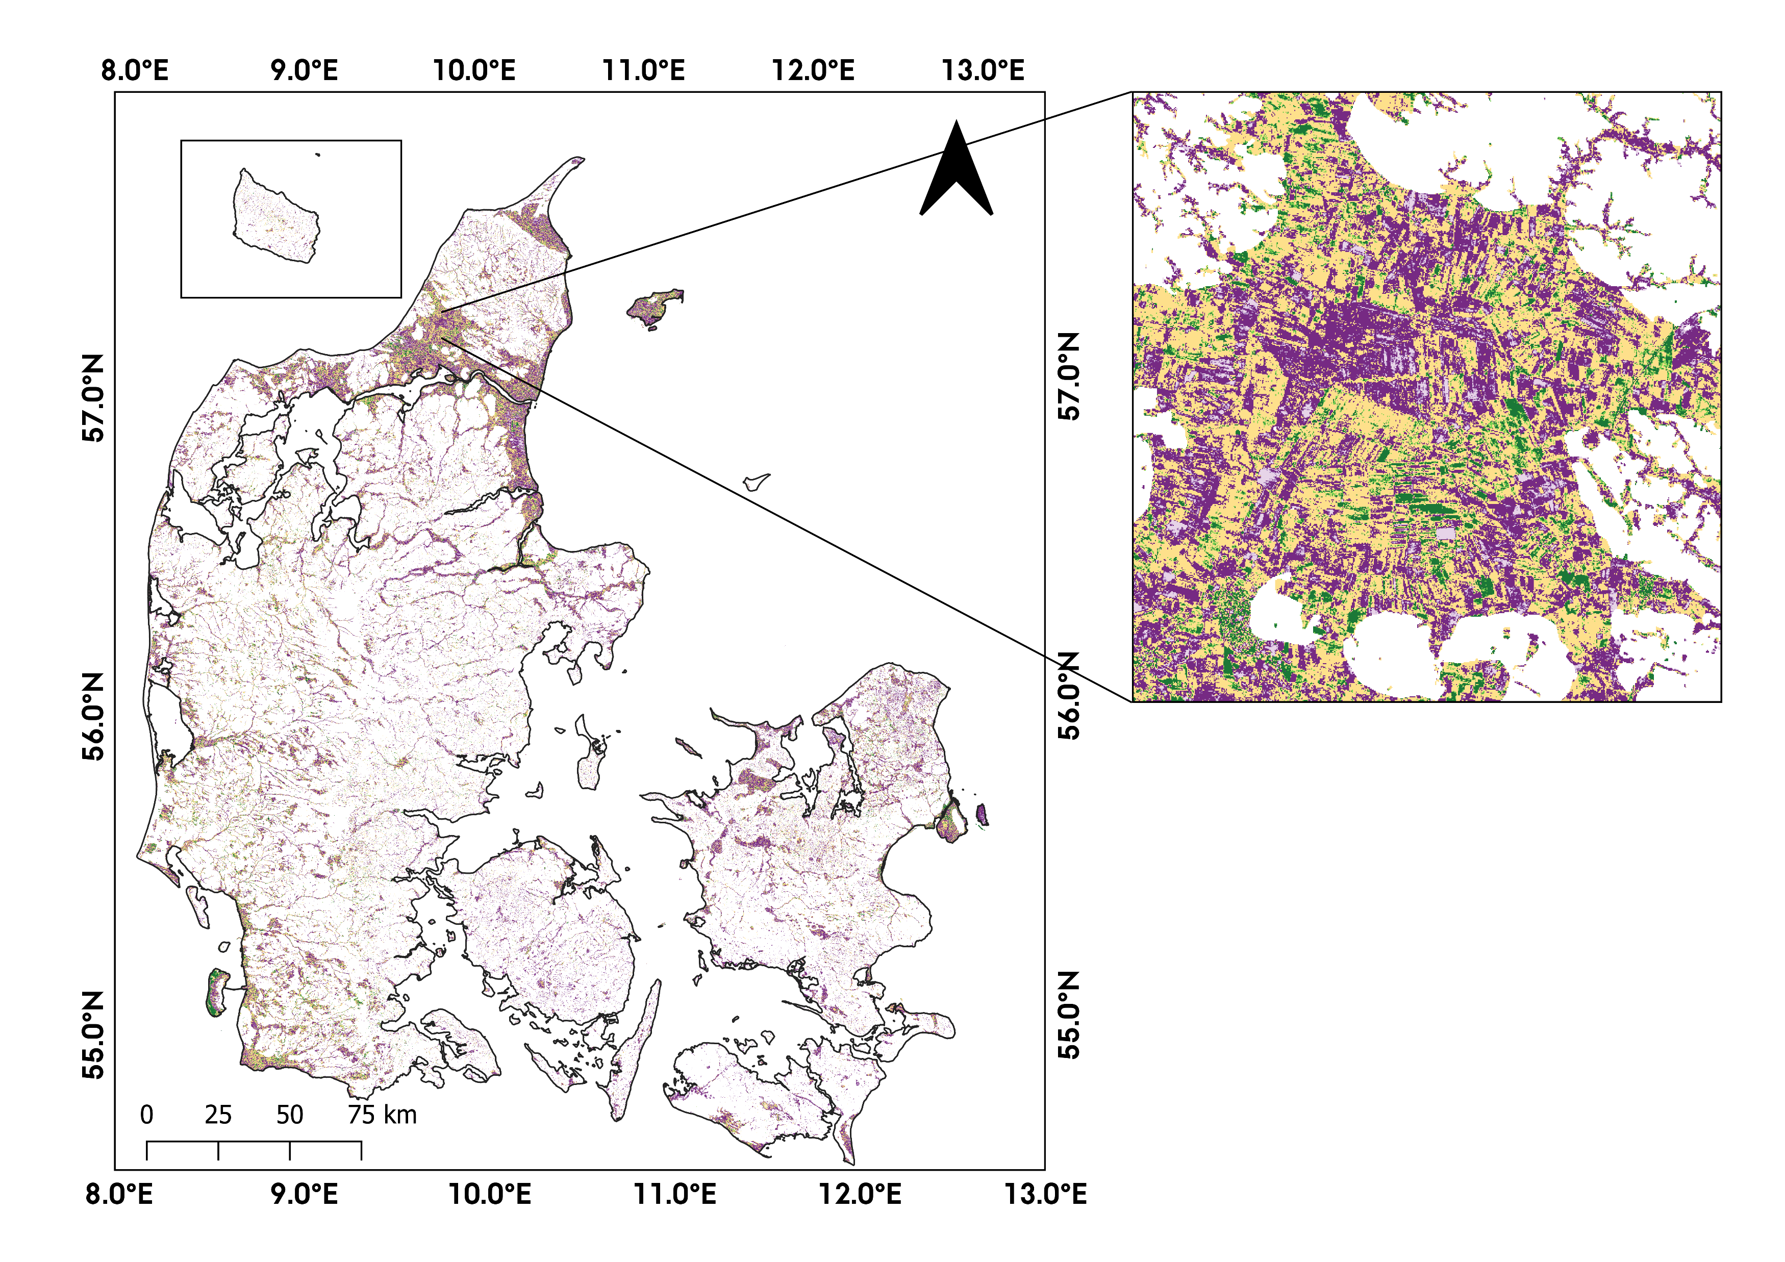
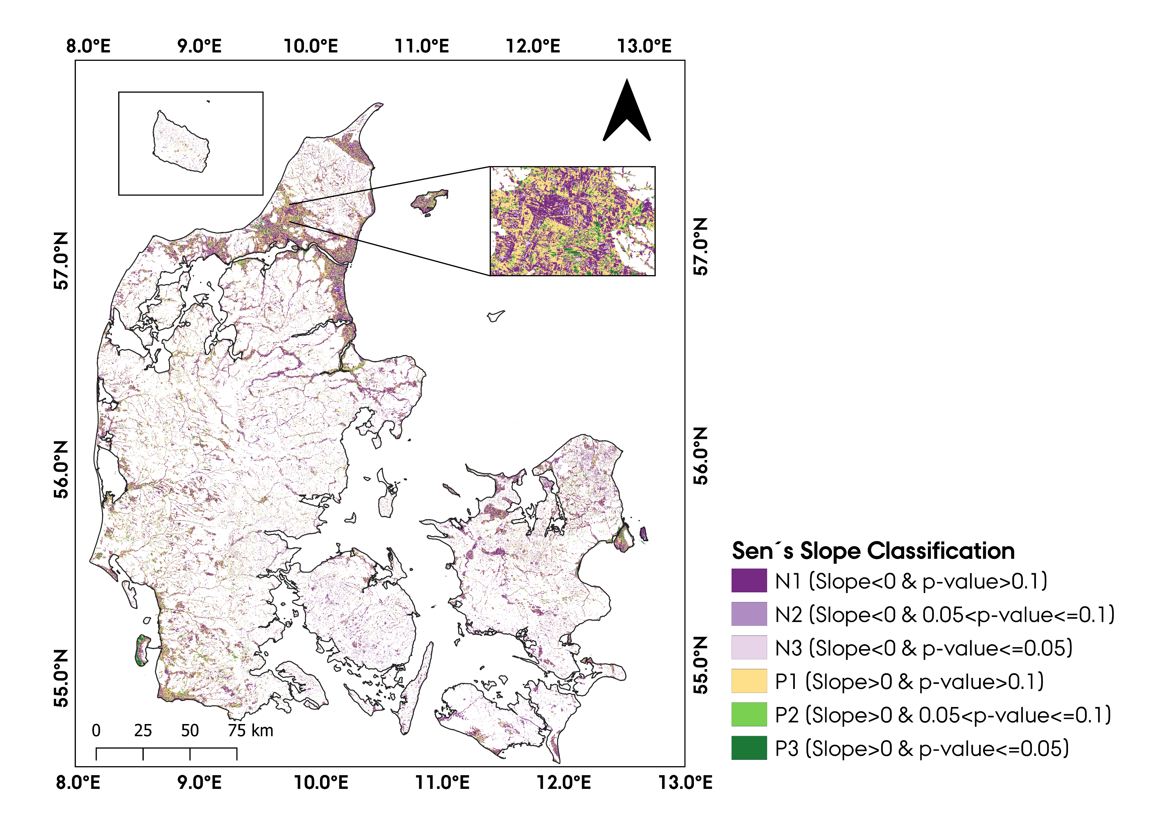
The contribution (%) of a given cell to the total Chi-square score
 | N1 | N2 | N3 | P1 | P2 | P3
FCr_Cr
FCr_Gr
FCr_WPr
FCr_WPm
FCr_F
Cr_FCr
Cr_Gr
Cr_WPr
Cr_WPm
Cr_F
Gr_FCr
Gr_Cr
Gr_WPr
Gr_WPm
Gr_F
WPr_FCr
WPr_Cr
WPr_Gr
WPr_WPm
WPr_F
F_FCr
F_Cr
F_Gr
F_WPr
F_WPm
findings
A significant association between the categories of the two variables (p<0.05).
The contribution of each cell to the total Chi-square score → nature of the dependency between land-use changes and NDVI trends.
Cropland-Wetland Cropland-Forest
Grasslands-Wetlands
Contribution (%)
FCr: Tree crop, Cr: Cropland, Gr: Grassland, WPr: Periodic wetland, WPm: Permanent wetland, F: Forest
Notes:
(+ Green) → positive association between corresponding columns and rows
(- Red) → negative association between corresponding columns and rows.
Changes from cropland to wetland and cropland to forest coincided with statistically significant (p≤0.05) negative NDVI, and positive NDVI trends, respectively. Changes from grasslands to permanent wetlands corresponded with statistically significant negative NDVI trends.

Slide 6
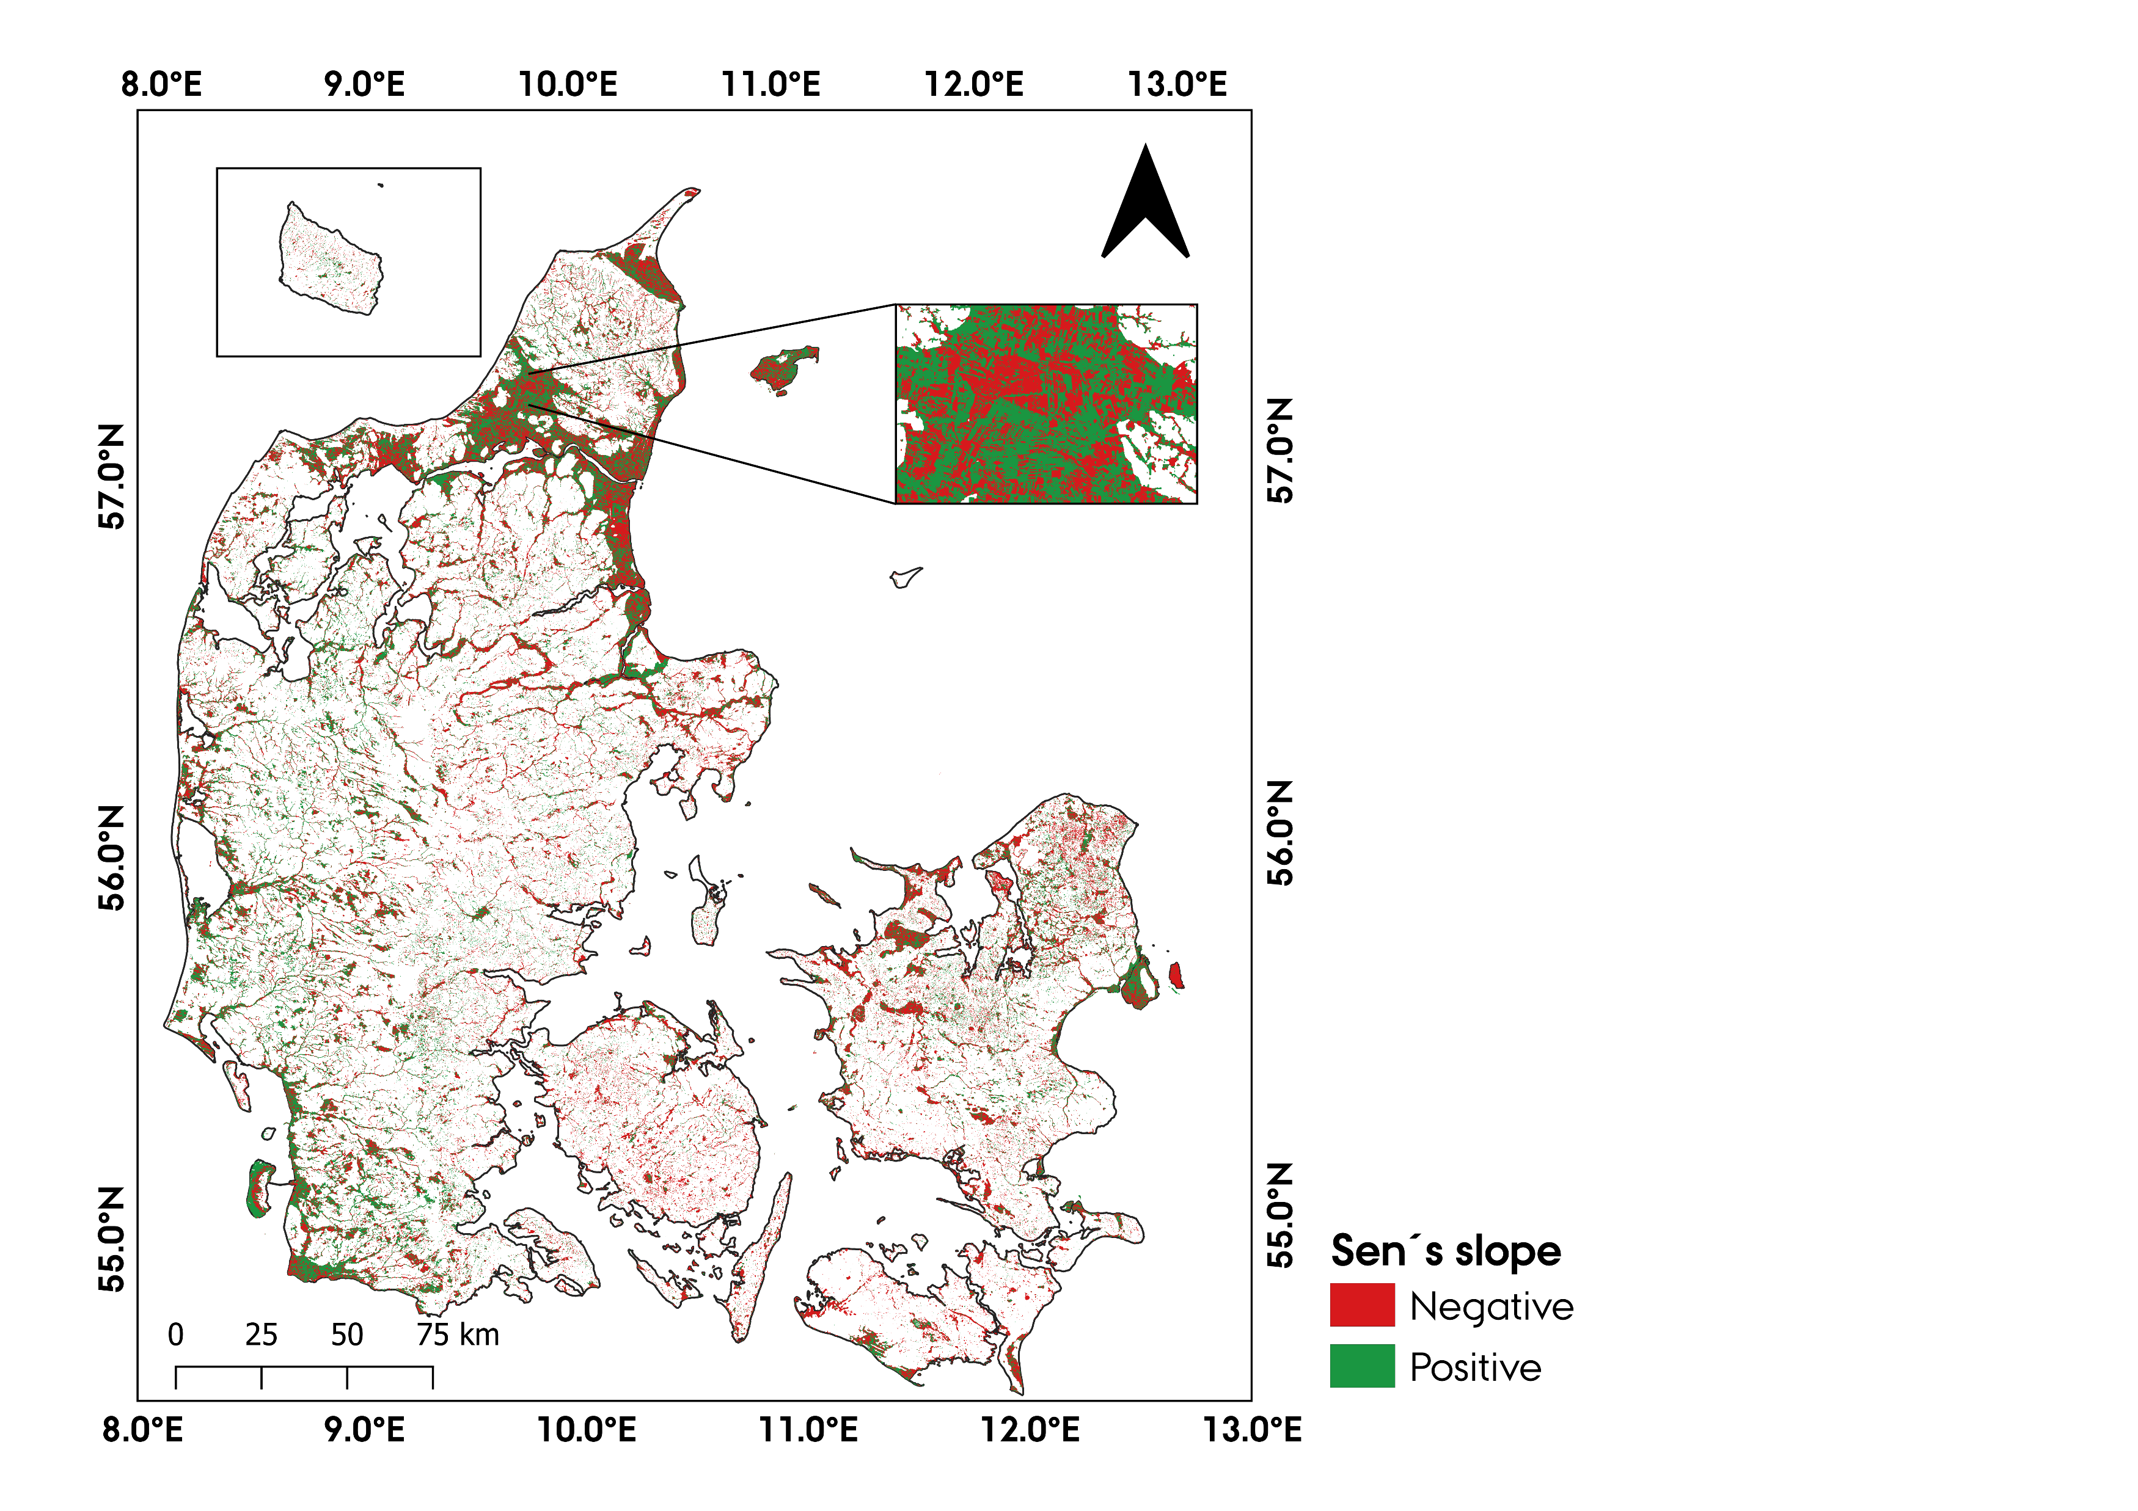
contrib=r2/χ2

